Slide 1
Bike share case study
Ahmed Mohamed Nassar
7/9/2022

Slide 2
Agenda
Business task
Our hypothesis
Data
Analysis and visualization
Important findings and recommendations

Slide 3
Business task
Our business task is to find out how members and casual riders use Cyclistic bikes differently to design a marketing strategy to convert casual riders to members.
Casual Member

Slide 4


Our hypothesis
We expect that members and casual riders have differences on why they use the bikes , As members might be using the bikes to commute to work or school . Along with some other differences which we will explore together.
Member
School
Work

Slide 5
Data
We will use Cyclistic's historical trip data for 12 months starting from ( 2022 - 05 To 2021 - 05).
The data was downloaded from (https://divvy-tripdata.s3.amazonaws.com/index.html) which is a public data and was made available by Motivate International Inc.

Slide 6
Analysis and visualization
We will explore how Members and casual riders use the different types of bikes. We have 3 different bike types :
Classic Docked Electric

Slide 7
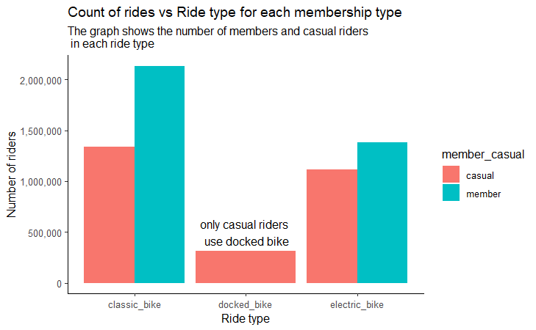
Analysis and visualization
As we can see the major difference here is that Casual riders use docked bikes and Members don`t

Slide 8

Analysis and visualization
Now we will explore how members and casual riders use bikes in different months of the year.

Slide 9
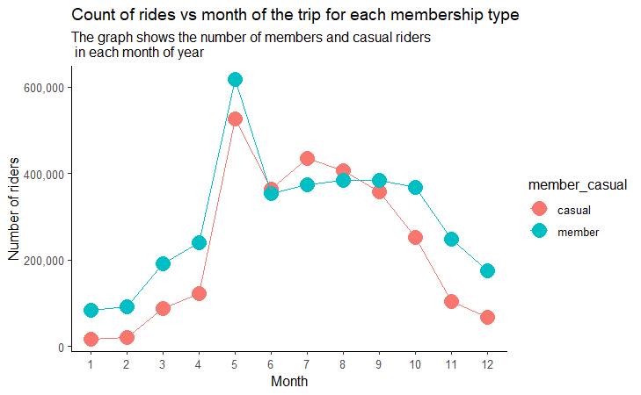
Analysis and visualization
As we can see the trends are almost similar for both casuals and members

Slide 10
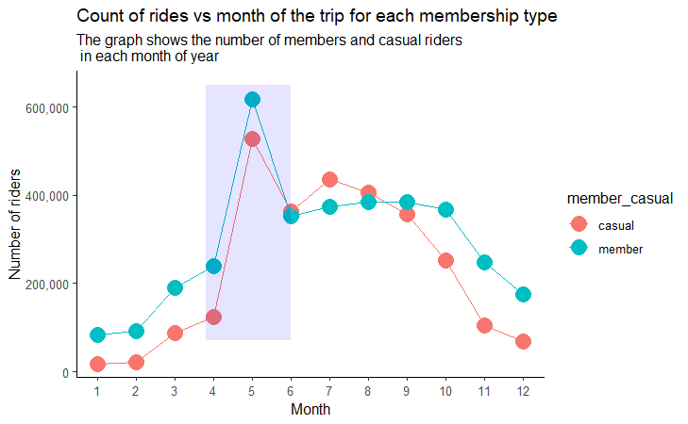
Analysis and visualization
We can see a significant increase In the number of riders for both types in month 5 -> 9

Slide 11
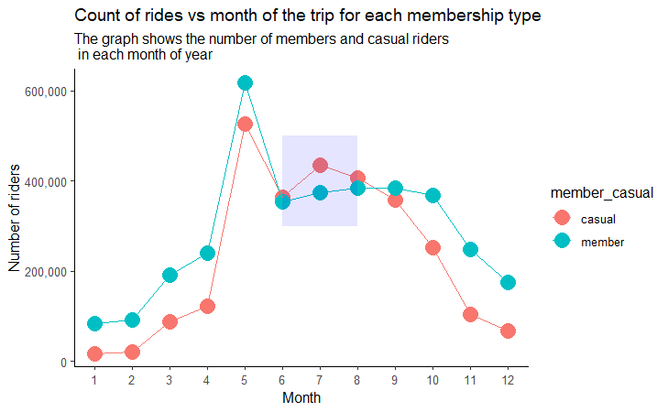
Analysis and visualization
In months 6 , 7 , 8 number of casual riders increase to be more than members

Slide 12

Analysis and visualization
Now we will explore further and analyze how Members and casual riders use the bikes in week days.

Slide 13
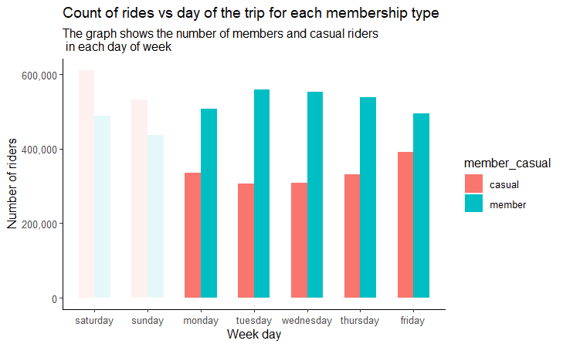
Analysis and visualization
As we can see number of Members rides are significantly Higher than casual rides on workdays (mon -> fri)

Slide 14
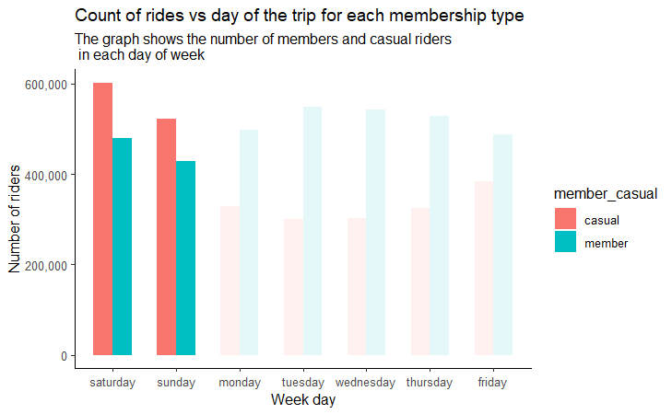
Analysis and visualization
At weekends (sat , sun) we notice a significant increase in casual Rides
There is no much difference between the number of rides In weekends or work days for members

Slide 15
Analysis and visualization
The last insight showed that members use the bikes on workdays more than casual riders .
That might indicate that members use bikes to commute more than casual riders , but we need further investigation.
Member

Slide 16

Analysis and visualization
To investigate more on the last insight we will explore how Members and casual riders use the bikes in different hours of day .

Slide 17
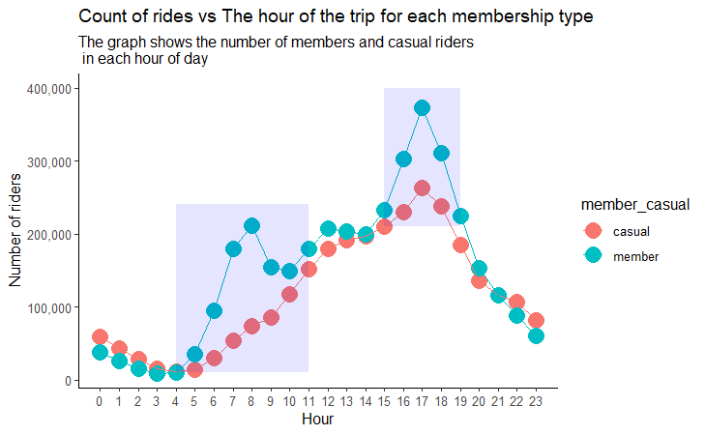
Analysis and visualization
We notice increase In bikes usage before and after working hours

Slide 18
Analysis and visualization
The increases are significantly high For members and lower for casual riders

Slide 19
Analysis and visualization
That is a strong indication that members use bikes to commute more than casual riders

Slide 20

Important findings and recommendations
Here are the important findings of our analysis:
Casual riders use docked bikes and Members don`t
Docked bikes

Slide 21

Important findings and recommendations
Here are the important findings of our analysis:
Significant increase In the number of riders for both types in month 5 -> 9

Slide 22

Important findings and recommendations
Here are the important findings of our analysis:
Members rides are significantly Higher than casual rides on workdays (mon -> fri)

Slide 23

Important findings and recommendations
Here are the important findings of our analysis:
At weekends (sat , sun) we notice a significant increase in casual Rides

Slide 24

Important findings and recommendations
Here are the important findings of our analysis:
Members rides are significantly Higher than casual rides before and after work hours

Slide 25



Important findings and recommendations
And here are our recommendations for more exploration:
We can explore if the members use their bikes to go to work places or study places on work hours and workdays using longitude and latitude information

Slide 26
Important findings and recommendations
And here are our recommendations for more exploration:
We can explore why casual riders use docked bikes and members don`t
Docked bikes

Slide 27


Important findings and recommendations
And here are our recommendations to convert casual riders to members using our findings:
Make more promotions on annual memberships during months 5 -> 9 and weekends as we can see the number of casual riders increase during this time .

Slide 28
Important findings and recommendations
And here are our recommendations to convert casual riders to members using our findings:
Make promotions on annual membership to casual riders who use their bikes to commute . And use the information we found out from the analysis to find the right timing for the promotion.

Slide 29
Thank you

